Slide 1



BIS 403 Applied System Design Peirce College Professor: Robert Heubner Group 2: Jilalo Sherif & Morrese Morrison Case Study: Personal Trainer Chapter Two Case Study Date: 1/27/2024 Tasks 1&2, completed by Jilalo Sherif Tasks 3&4, completed by Morrese Morrison

Slide 2
Fitness Center Operations
On-demand Personalized Training
Customer Experience
Fitness inclusion
Group Fitness
Information Technology Systems
Nutrition Counseling

Slide 3
Finess Center Operations
Sales and Customer Acquisition
Security
Emergency Exit Preparedness
Children's Programming & Safety
Diversity, Equity, & Inclusion (DEI)
Member Registration
24/7 Online Access

Slide 4
SWOT Analysis Strengths:
Excellent Customer Service
Upgraded Facility
24/7 Service
Online Access
Specialized Equipment
Experienced Personal Trainers

Slide 5
SWOT Weaknesses
Training Newly Hired Staff
New Location Familiarization
Snowy Weather
High Membership Costs

Slide 6
SWOT Opportunities:
Expansion in the New Location
Diversified Staff with Different Backgrounds
Increasing Clientele
Digital Fitness Programs
Partnerships
Health and Wellness Trend

Slide 7
SWOT Threats:
Stiff Competition
Government Rules
Cost of Ownership
At-home Fitness Trend
Economic Fluctuations

Slide 8
Business Case? Yes, because:
• Why are we doing this project?
Expansion of Personal Trainer Supercenters that has a dozen branches
• What is the project about?
Toronto Area modern Supercenter as part of international expansion
• How does this solution address key business issues?
Attracting new clientele, income growth, profitability

Slide 9
Business Case? Yes, because:
• How much will it cost and how long will it take?
90-day Schedule, $1m
• Will we suffer a productivity loss during the transition?
Unlikely as it is a new store at a new location
• What is the return on investment and payback period?
10% of $1m (i.e $100,000) and 1-year from grand opening

Slide 10
Business Case? Yes, because
• What are the risks of doing the project?
Hiring experienced manpower and stiff competition
• What are the risks of not doing the project?
Missing of the Personal Trainer's vision and mission of expansion and reach of new clientele
• How will we measure success?
On time performance, within budget, opening the supercenter
• What alternatives exist
Scanning other metro areas of the NE of Canada

Slide 11
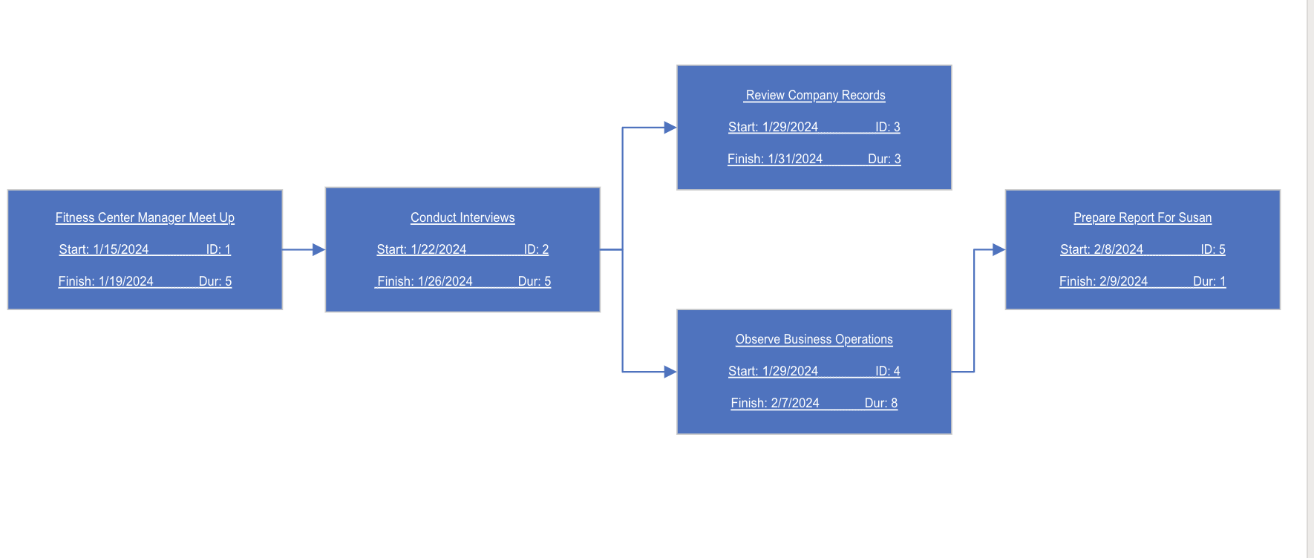
PERT CHART

Slide 12
Critical Path
The critical path is a series of tasks if delayed would affect the completion date of the overall project.
The overall duration of this project is from 1/15/2024 to 1/31/2023 which amounts to 13 days.
The critical path for this project include ID #2 and critical ID #3, if these tasks are delayed this will affect the completion date of the overall project.

